Slide 1

Sequence and collaboration diagrams

Slide 2

Interaction Diagram:
Interaction diagram consisting of arcs and set of objects their relationships including messages that pass from object to another object.
Addresses the dynamic view
It has specialized types
Sequence Diagram
Collaboration Diagram

Slide 3
Collaboration and sequence - differences
Collaboration diagram illustrates object interactions in a graph or network format, in which objects can be placed anywhere on the diagram. It demonstrates how objects are statically connected.
Sequence diagram illustrates interaction in a kind of fence format, in which each new object is added to the right. It generally shows the sequence of events that occur.

Slide 4
Sequence diagrams
A sequence diagram shows relations between objects.
It should be read from left to right and from top to bottom.
At the top of the diagram are names of objects that interact with each other. These are the concepts in the conceptual model.
When the course of events is initiated by an actor the actor symbol is displayed as the leftmost object.

Slide 5

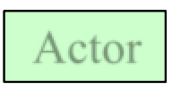
Sequence diagrams: an example
d : class
: o bject2
: object3
: Custom er
Actor
Instances
of classes

Slide 6










:object3
Sequence Diagram: Lifelines
:object1 :object2
:actor
Time
Each object has a lifeline. Time flows from top to down.

Slide 7





Sequence diagrams: rectangles
:object1 :object2
:object3
:actor
Time
Rectangles refer to events that are related to each other.

Slide 8






Sequence diagrams: messages
:object1 :object2
:object3
:actor
Time
Arrows indicate messages that are sent from one object to another.

Slide 9
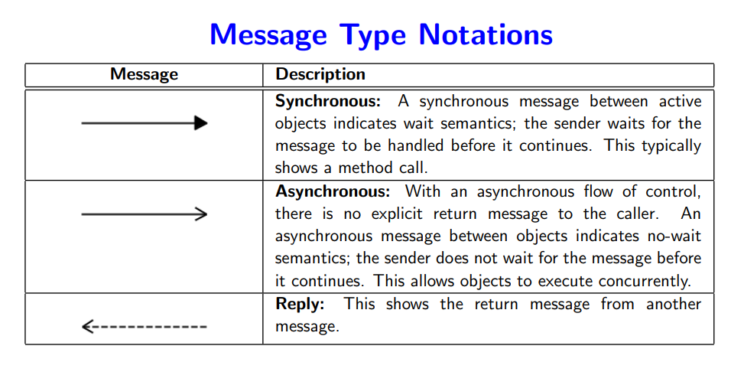

Slide 10
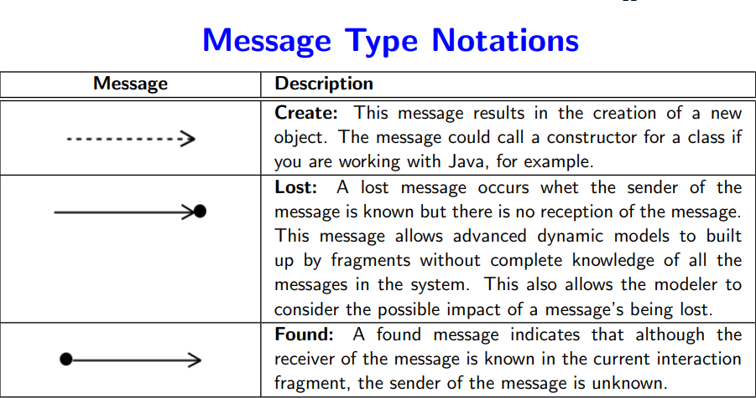

Slide 11







Sequence diagrams - different types of messages
: obje ct1 : o bject2 : obje ct3
: Custom e r
re q ue s t( )
cre ate Obje ct3( )
Message
cre ate ( )
An object sends a
message to itself.
Feedback arrow shows that a value is returned.

Slide 12





Sequence diagrams: endpoints
: obje ct1
: o bject2
: obje ct3
: Custom e r
re q ue s t( )
cre ate Obje ct3( )
cre ate ( )
X at the end of the lifeline shows that the object ceases to exist.

Slide 13
Sequence Diagram:
Let's assume changing the channel of your television using a remote control. The TV viewer starts the entire process. The use of the remote which will then interact with the TV. Let's assume the TV is already on and the TV viewer wants to change her channel. The first thing that happens is the TV viewer presses the numbers on the remote to tell it which channel to go to. The remote then sends a new message to the television to change the channel to number and TV will display the desired channel.
If TV viewer is unsure what channel to go to and would like to surf the channels until they find a channel they like The TV viewer is going to press the up or down arrow on the remote to browse through the channels. This sends a message to the remote. The remote will then send a message to the TV with this action. Just like in the initial sequence, the TV changes the channel and displays that to the TV viewer

Slide 14

Sequence diagram: a more complex example
: Res ervationSys tem
: Authoris ationSys tem
: VideoCopy : VideoSpecification
: Bo okedIte ms Li st
: Cus tom er
lookFor(title)
che ckVali dity()
Indicates explicit object destruction
checkAvailibility(title)
che ckAvaili bili ty(titl e)
createBookedItem s Lis t( )
create( )
add()

Slide 15
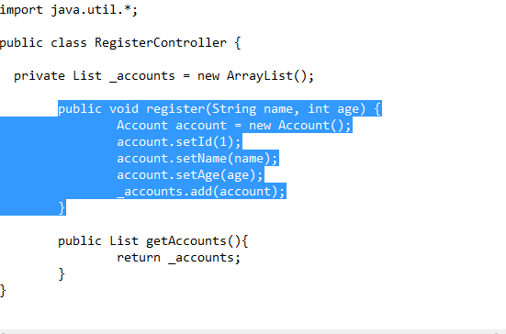
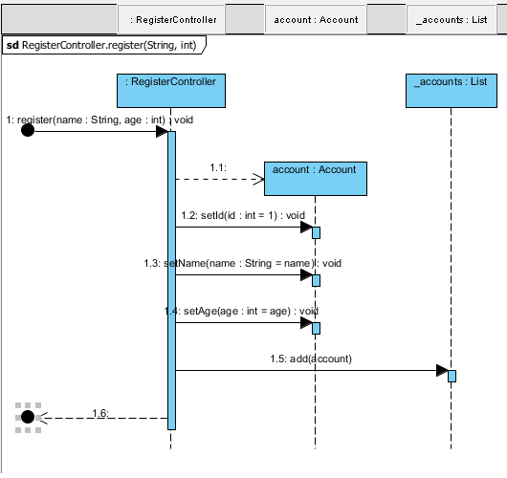
Generate Sequence Diagram

Slide 16
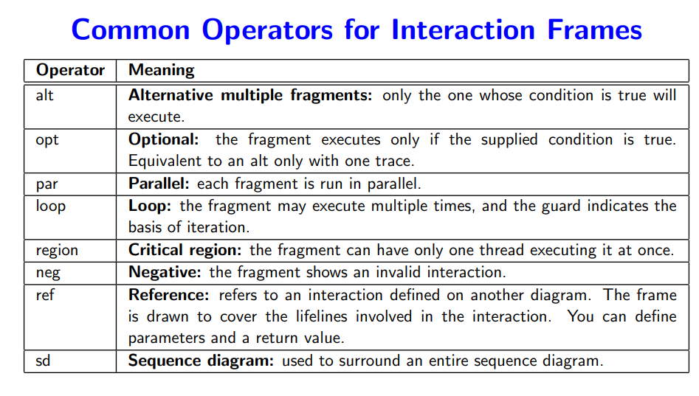
Frames in UML Sequence Diagram:

Slide 17
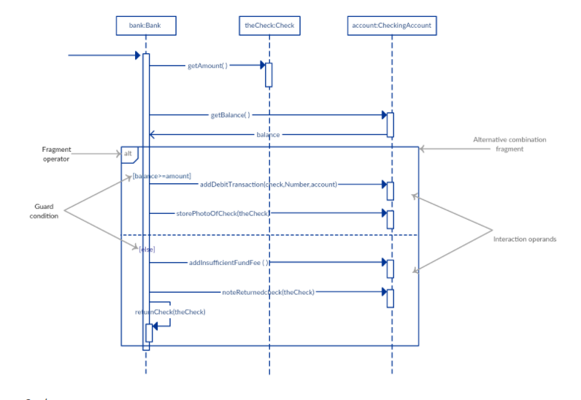
Alternatives: alt

Slide 18
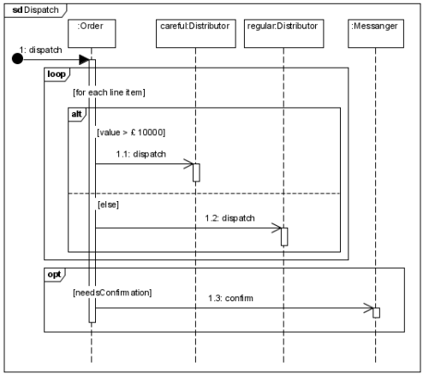

Slide 19
Sequence diagrams - strengths and weaknesses
Strengths:
they clearly show sequence or time ordering of messages
the notation is rather simple
Weaknesses:
forced to extend to right when adding new objects, consumes a lot of space

Slide 20
Collaboration/Communication Diagram:
A collaboration diagram shows the relationship between objects and the order of messages passed between them.
The objects are listed as icons and arrows indicate the messages being passed between them.
The numbers next to the messages are called sequence numbers and, as the name suggests, they show the sequence of the messages as they are passed between the objects.

Slide 21
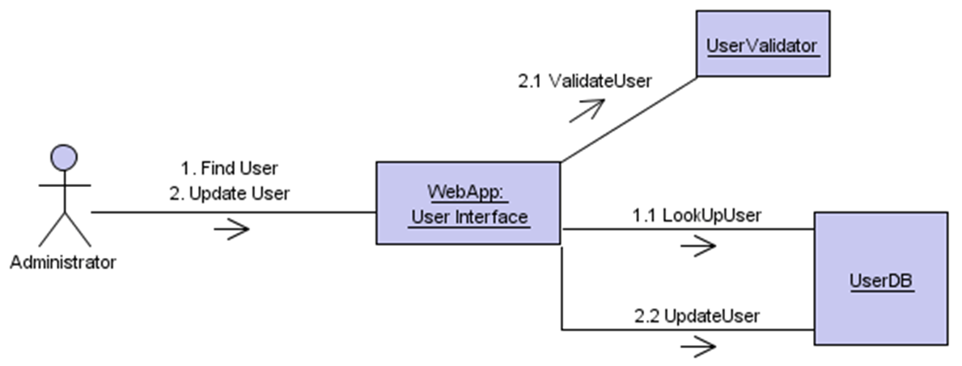
Collaboration diagram – an example

Slide 22
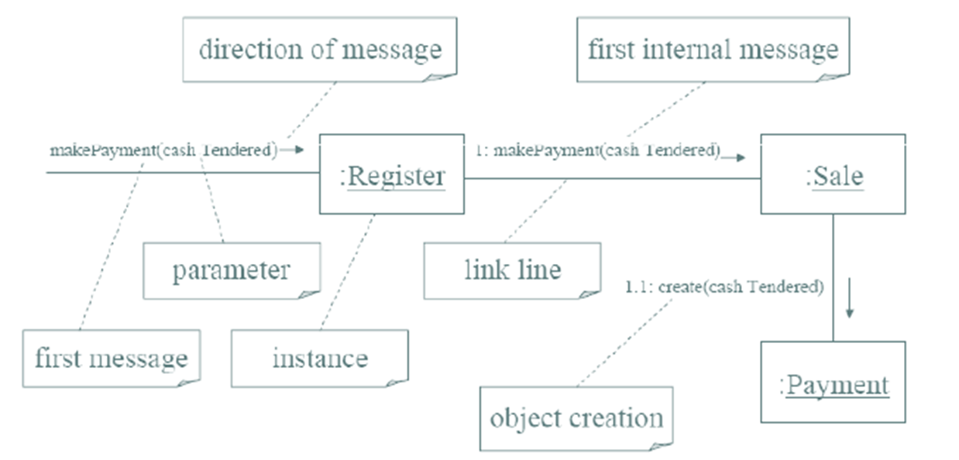
Example of Collaboration Diagram “Make Payment”

Slide 23
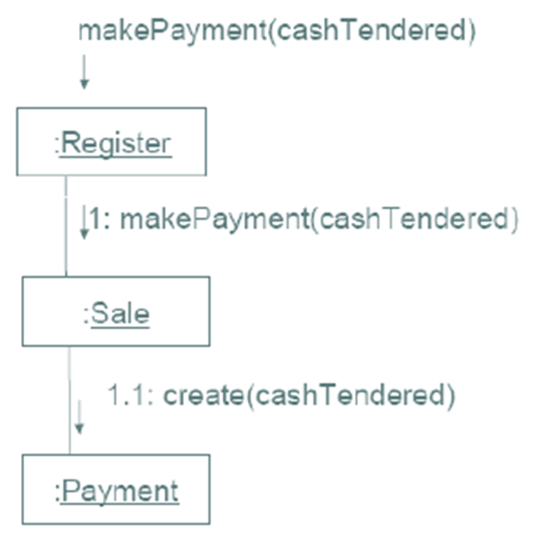
How to read “Make Payment” Collaboration Diagram
The message makePayment is sent to an instance of Register. The sender is not identified.
The Register instance sends the makePayment message to a Sale instance.
The Sale instance creates an instance of a Payment.

Slide 24
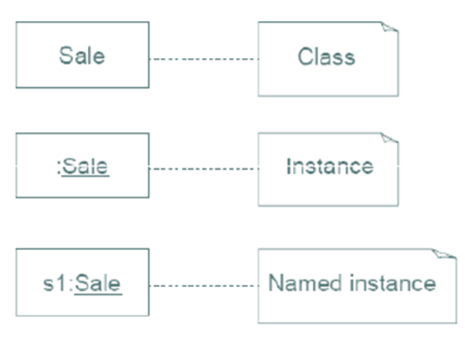
Common Interaction Diagram Notation
Illustrating Classes and Instances:
To show an instance of a class, the regular class box graphic symbol is used, but the name is underlined. Additionally a class name should be preceded by a colon.
An instance name can be used to uniquely identify the instance.

Slide 25
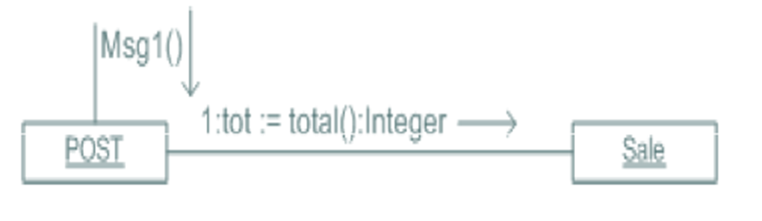
Collaboration Diagram Notation:
Links, Messages and Return Value

Slide 26
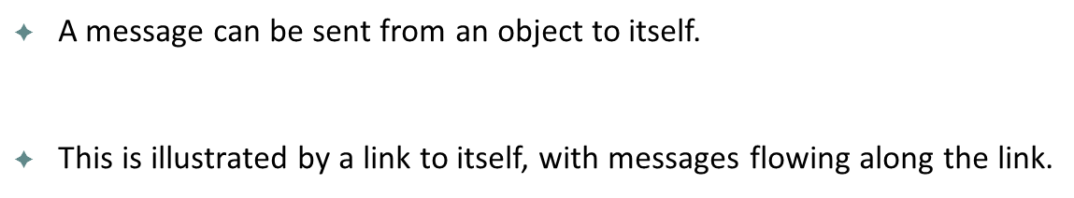
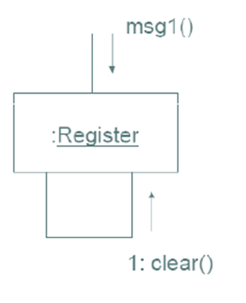
Collaboration Diagram Notation:
Messages to “Self” or “This”

Slide 27
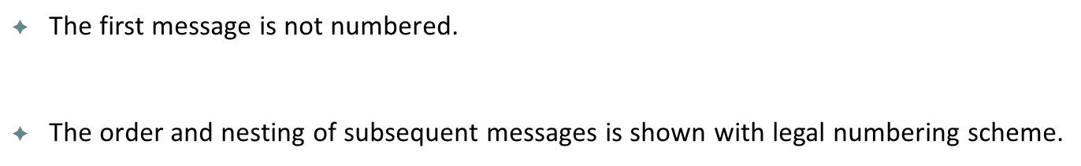
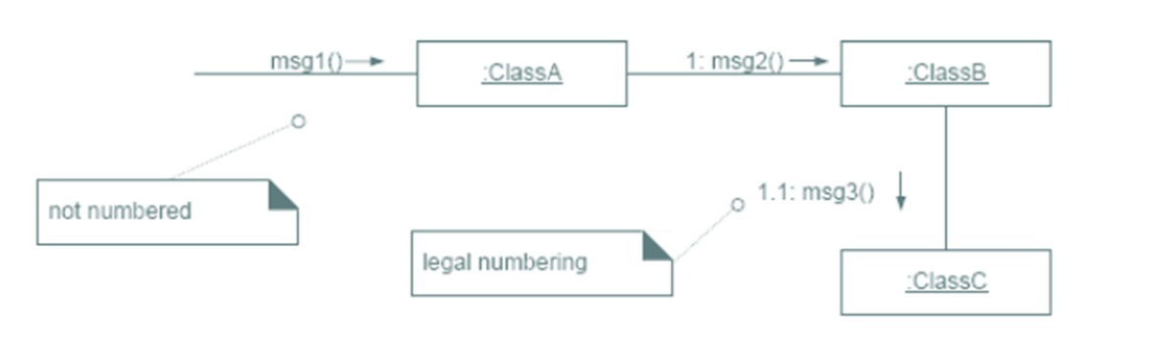
Collaboration Diagram Notation:
Message Number Sequencing

Slide 28
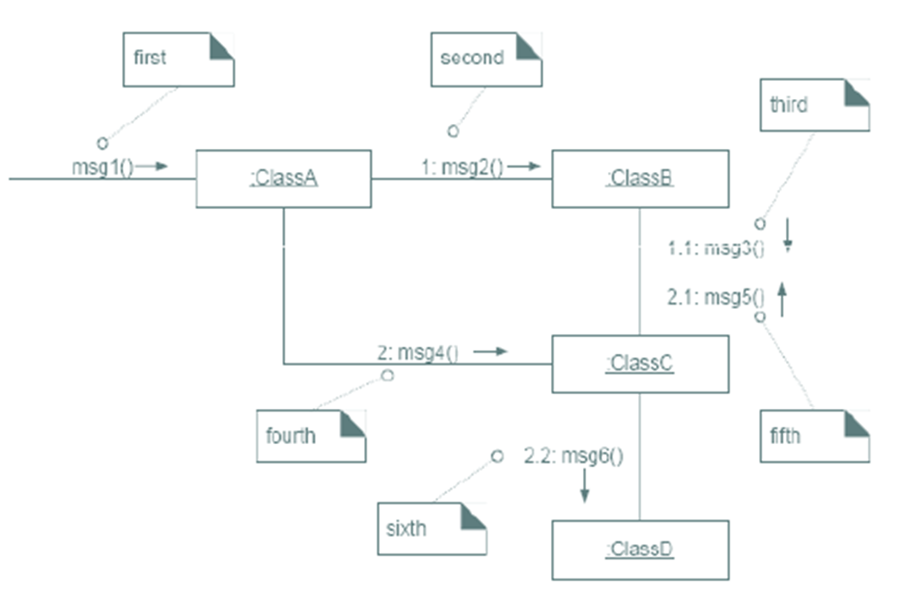
Continue…

Slide 29
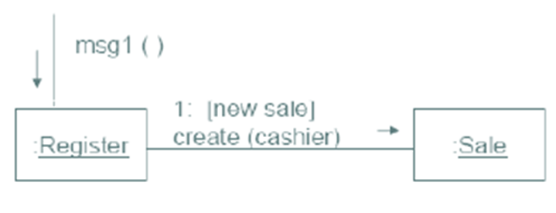
Collaboration Diagram Notation:
Conditional Messages
A conditional message is shown by following a sequence number with a conditional clause in square brackets, similar to the iteration clause.
The message is sent only if the clause evaluates to true

Slide 30
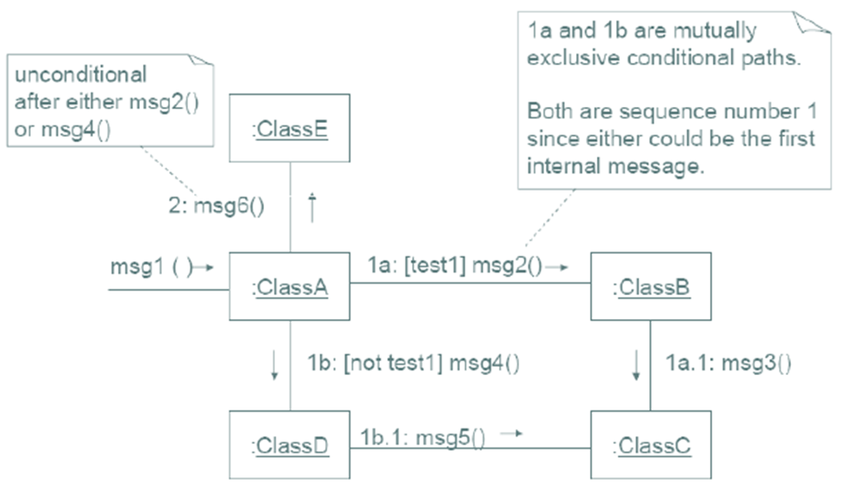
Collaboration Diagram Notation:
Mutually Exclusive Conditional Paths

Slide 31
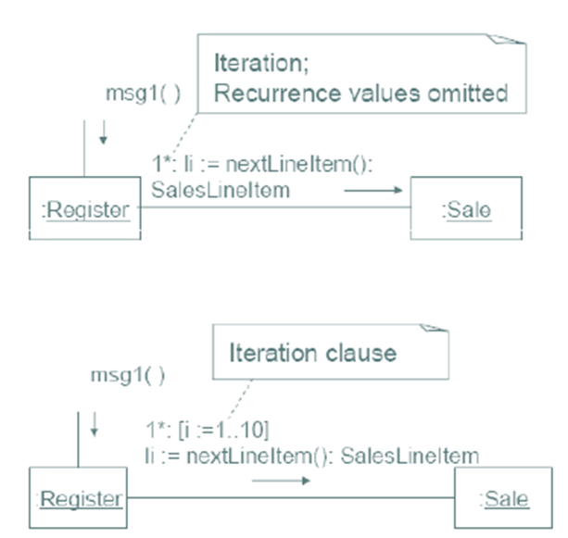
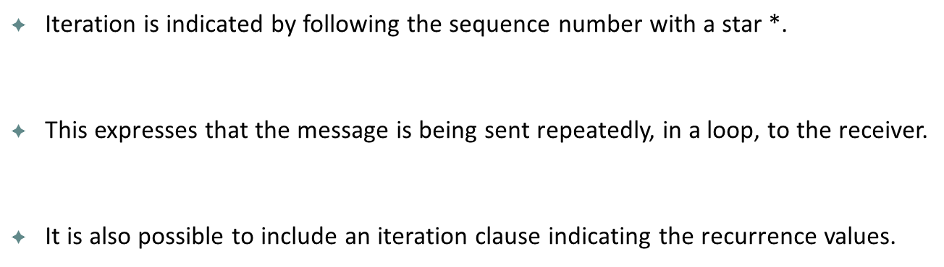
Collaboration Diagram Notation:
Iteration or Looping

Slide 32

Consider the software that controls a very simple cellular telephone. Such a phone has buttons for dialing digits, and a “send” button for initiating a call. It has “dialer” hardware and software that gathers the digits to be dialed and emits the appropriate tones. It has a cellular radio that deals with the connection to the cellular network. It has a microphone, a speaker, and a display

Slide 33
Use case: Make Phone Call
1.User presses the digit buttons to enter the phone number.
2. For each digit, the display is updated to add the digit to the phone number.
3. For each digit, the dialer generates the corresponding tone and emits it from the speaker.
4. User presses “Send”
5. The “in use” indicator is illuminated on the display
6. The cellular radio establishes a connection to the network.
7.The accumulated digits are sent to the network.
8. The connection is made to the called party.

Slide 34
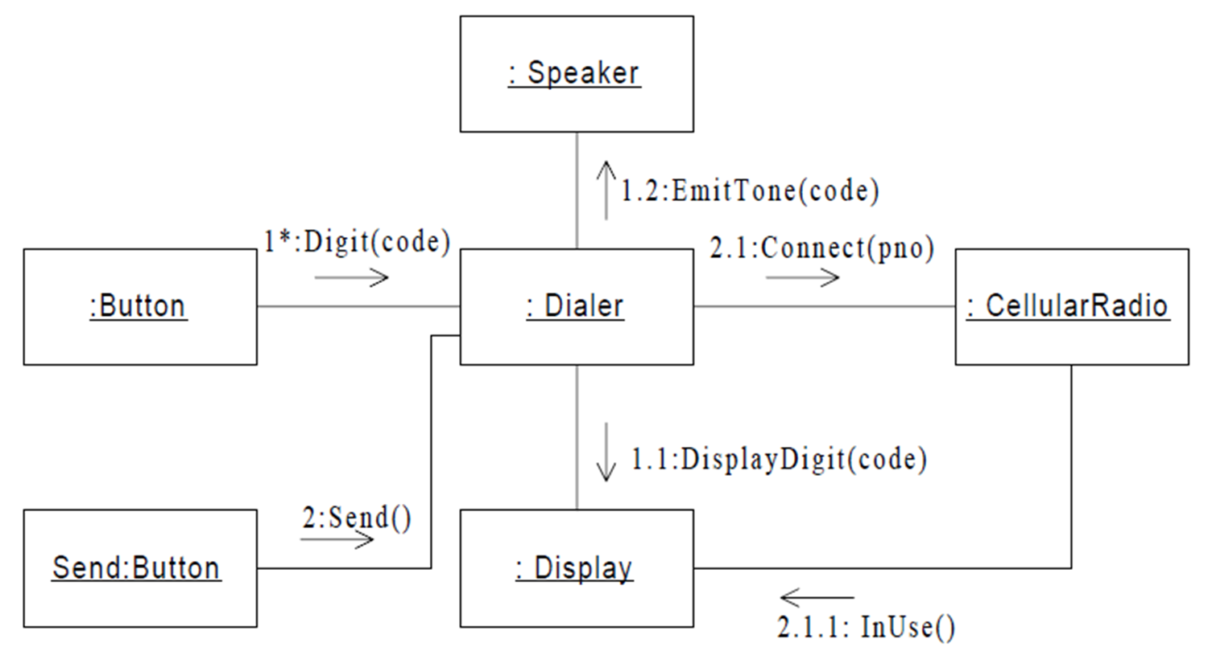

Slide 35
One of the greatest strengths of collaboration diagrams is their simplicity.
The principal weakness, however, is that although they are good at describing behavior, they do not define it. They typically do not show all the iteration and control that is needed to give an computationally complete description.

